Slide 1
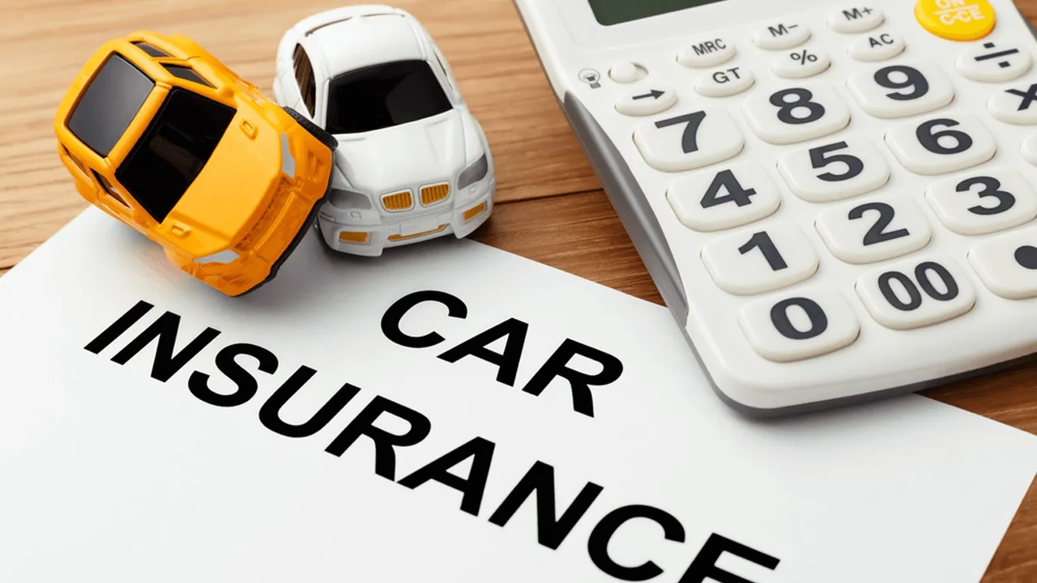
February 2023
Car Insurance Claims
Numann Malik

Slide 2
February 2023
Car Insurance Dataset
The dataset was sourced from the Kaggle – Car Insurance Dataset from the user ‘Sagnik Roy’.
This dataset utilizes 18 features for predicting auto insurance claims. The ‘Outcome’ target feature below indicates whether a customer filed a claim (1) or not (0).
Feature Name | Description | Feature Name | Description | Feature Name | Description
Age | 16-25, 26-39, 40-64, or 65+ | Credit Score | Between 0 and 1 (scaled) | Annual Mileage | Rounded to nearest 1000 miles
Gender | Male or Female | Vehicle Ownership | 0 (no) or 1 (yes) | Vehicle Type | Sedan or Sports Car
Race | Majority or Minority | Vehicle Year | Before 2015 or After 2015 | Speeding Violations | Numerical Frequency
Driving Experience | 0-9, 10-19, 20-29, or 30+ years | Married | 0 (no) or 1 (yes) | DUIs | Numerical Frequency
Education | High School, University, or None | Children | 0 (no) or 1 (yes) | Past Accidents | Numerical Frequency
Income | Poverty, Working Class, Middle Class, or Upper Class | Postal Code | 10238, 21217, 32765, or 92101 | Outcome | 0 (no) or 1 (yes)

Slide 3


February 2023
Project Description
We analyzed behavioral data for the customers of a car insurance company (also stakeholder).
The goal was to identify key factors that are more likely to lead a customer to filing an insurance claim (e.g. for an accident).
Based on our analysis our stakeholder will decide how to set customer premiums, or consider denying them coverage (so as to maximize their profits or minimize their losses).

Slide 4
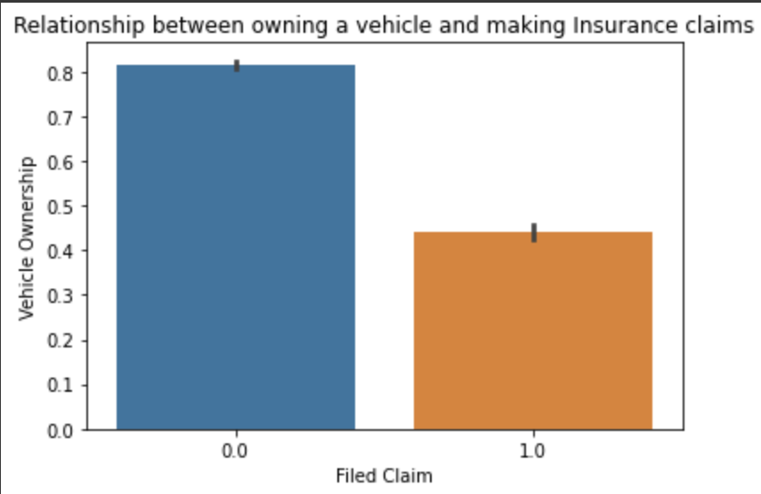
February 2023
Relevant Observation
Disparity within vehicle ownership.
How many customers never made an insurance claim?
How many customers who don’t own a vehicle made a claim?

Slide 5
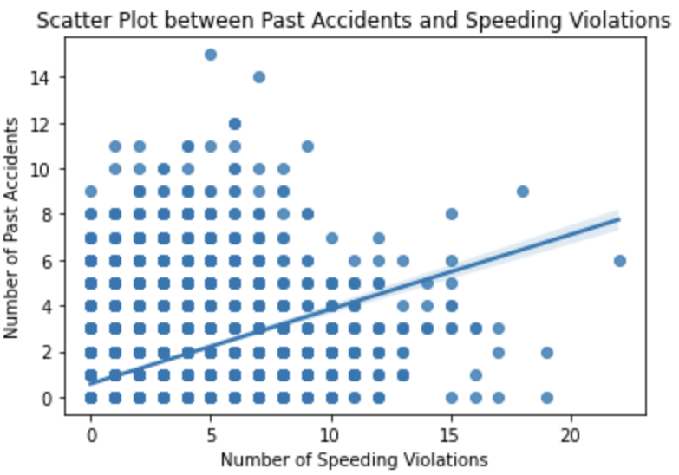
February 2023
Another Relevant Observation
Two key features for our predictions

Slide 6
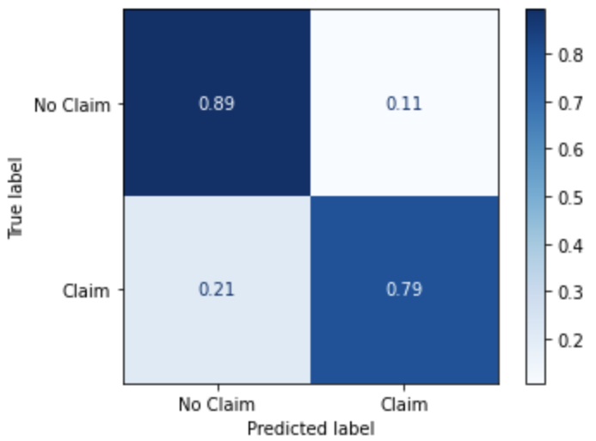
February 2023
Best Model Evaluation and Recommendations
We recommend our tuned LightGBM model since
It predicted 79% of customers who will file claims, with accuracy of 86.2%.
It predicted 89% of customers who will not file a claim.
We recommend more scrutiny of potential customers who
lease (or who otherwise don't own) their vehicles
have a history of speeding violations and accidents.

Slide 7
Thank You!
Any further questions?
Contact Info:
Email address
LinkedIn
Github

